Slide 1
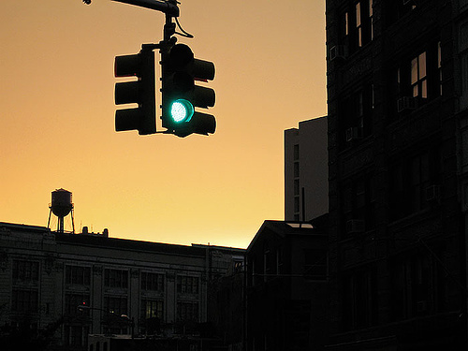
Traffic Intersection
By: Tori Garrick, Blaine Menelik, Ray Akinlosotu

Slide 2
Goals & Objectives
Create a realistic model of a traffic intersection using geometries & models in Autodesk 3ds Max.
Allow user to visualize how the traffic intersection works; traffic lights changing/cars driving.
We wanted to implement an environment where the user could get the vehicle to move from point A to point B by clicking a sensor.

Slide 3
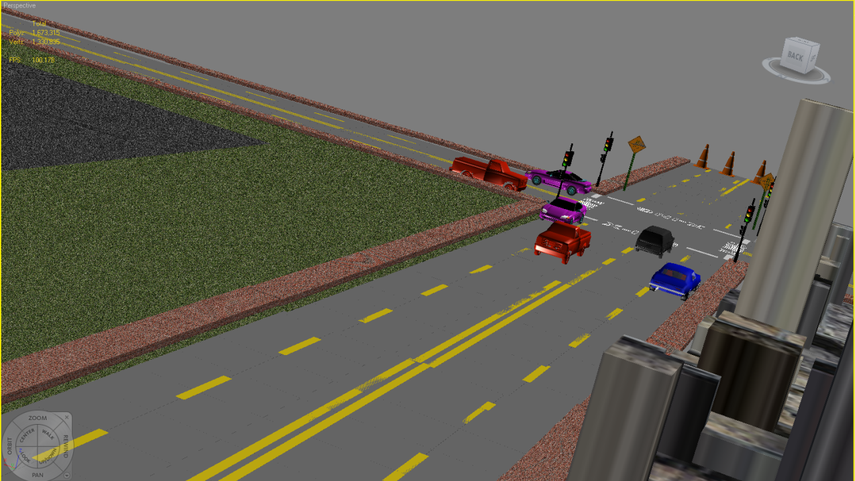
Screenshots in 3ds Max

Slide 4
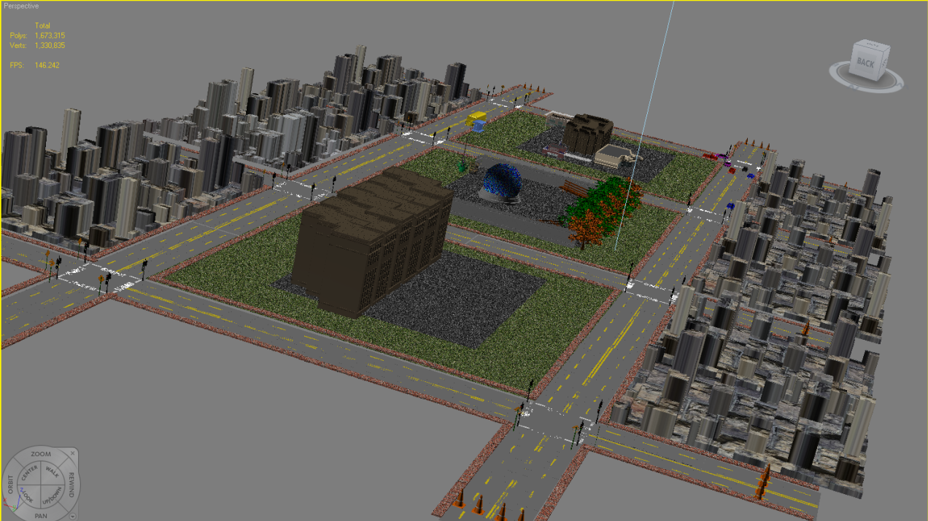
Screenshots cont’d

Slide 5
Models & Textures Used
Cars
Buildings
Stoplights
Benches
Stop Signs
Utility Poles
Sidewalks (texture)
Grass (texture)
Building Color (texture)

Slide 6
Problems Encountered
Finding models & textures that are free.
The grass and sidewalk textures were hard to find.
Having the textures convert to VRML.
The a couple of the files we downloaded from the websites would not open in 3ds max.
Getting the cars to stay leveled on the road.

Slide 7
Shortcomings
We had difficulties importing the human models
It was hard to find curved roads to connect our streets together.
Making the traffic lights change colors.

Slide 8
Virtual Reality
Virtual Reality was appropriate technology for this simulation because it lets the user view the traffic intersection from the view of their choice.

Slide 9
Software/Hardware Used
Autodesk 3ds Max
VRML
Cosmo Player

Slide 10
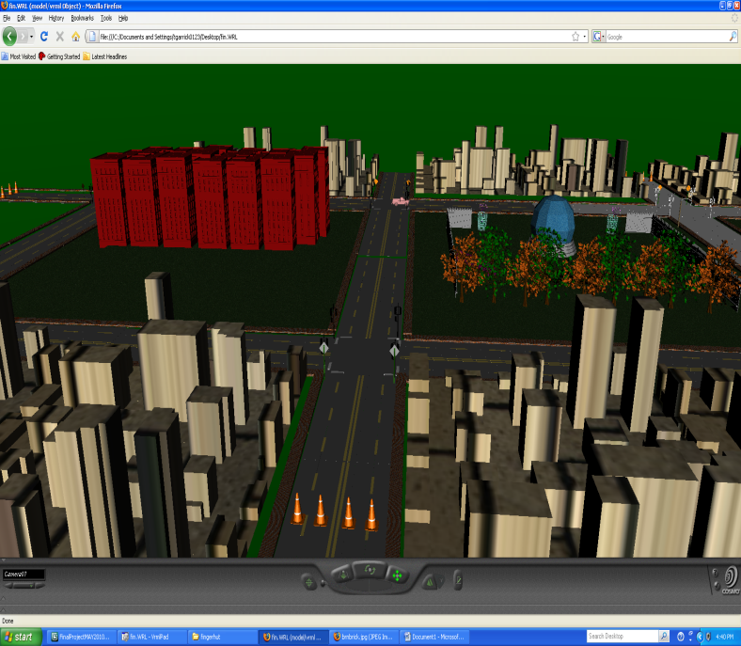
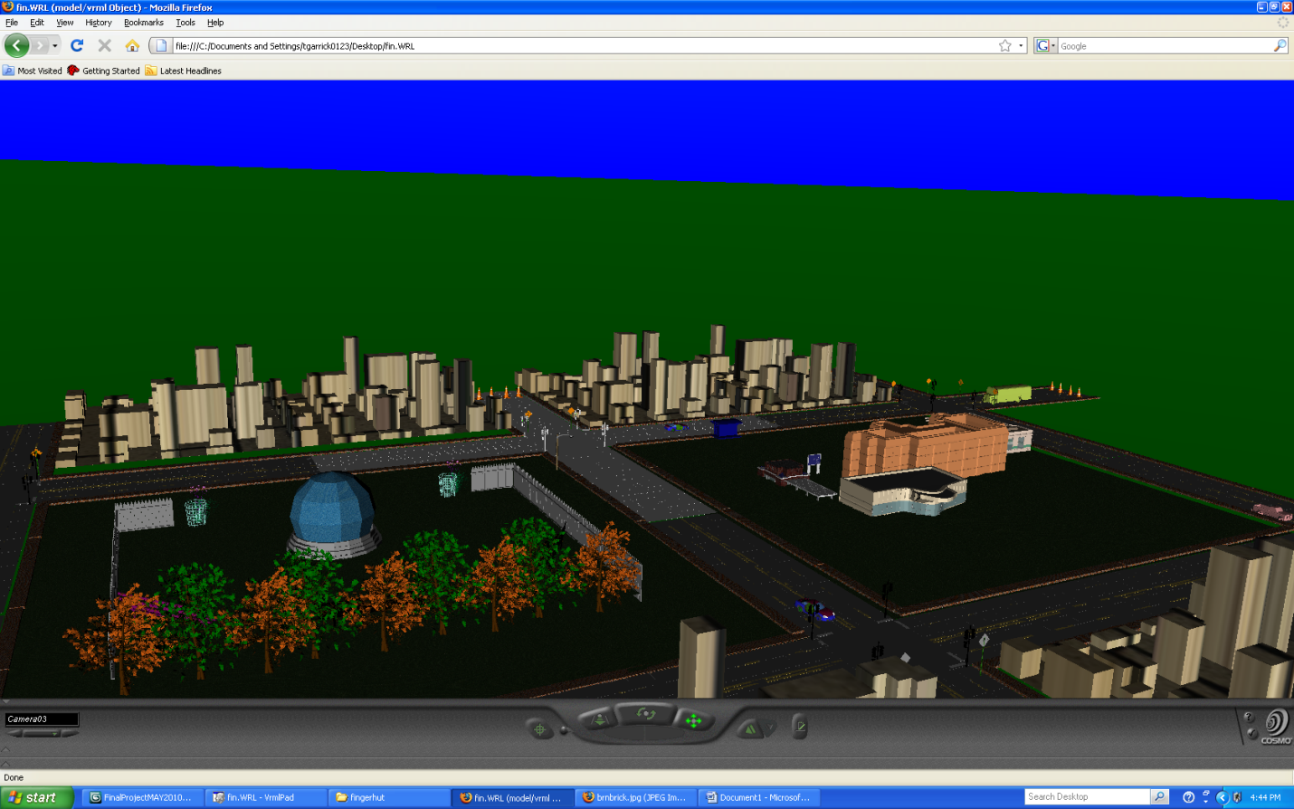
VRML Screenshots

Slide 11
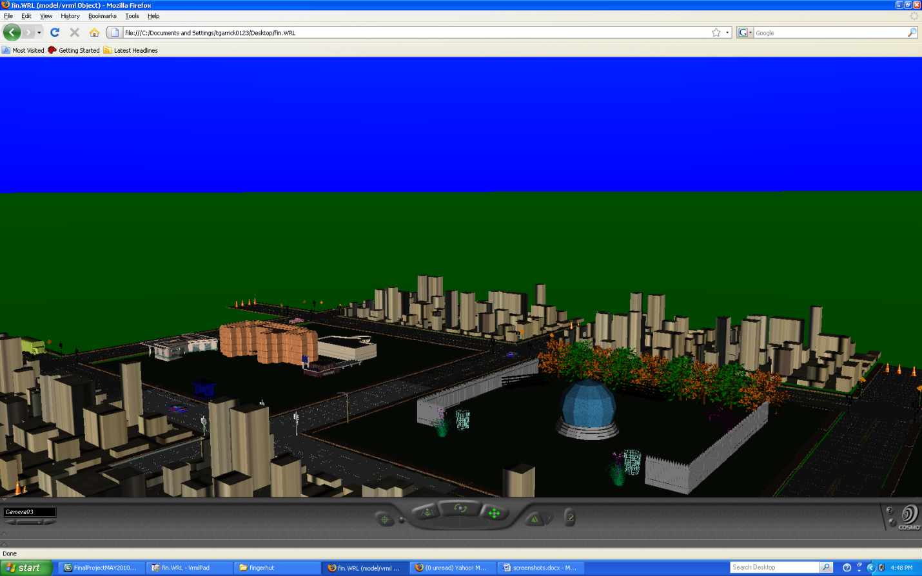
VRML screenshots cont’d

Slide 12
Recommendations
Could be used to teacher students in Drivers Ed by adding some functionalities.

Slide 13
Questions & Comments ?!

